Slide 1

Sentiment Analysis for Financial News
BY:
Nicholas Jay Sander
Aaron Tian
Ruby Nguyen

Slide 2
Motivation
Why sentiment analysis on financial news?
Sentiment analysis can be used to analyze and predict market behavior and trends.
Sentiment analysis is faster and cheaper than old market surveying techniques.
Scope of our project:
To better understand the task and its benefits.
To establish a new baseline performance and propose future direction.

Slide 3
Previous Work
BERT for Stock Market Sentiment Analysis (Matheus Gomes de Sousa, et al. 2019)
Primary inspiration for our methodologies, using the same data set and testing several different models (CNN, BERT-base, Naive Bayes BOW, SVM BOW, Naive Bayes tfidf, and SVM tfidf).
The best model was BERT-base and achieved a macro f1-score of 0.73.
Demonstrated 69% consistency with changes in Dow Jones Industrial Index and sentiment labels from gold data.
Measuring News Sentiment (Shapiro, Adam Hale, Moritz Sudhof, and Daniel Wilson. 2017)
Large data set of 238,685 news papers from between 1980 and 2015, with 800 articles manually annotated.
Multi-class classification (ordinal scale of 1 - 5), examined GloVe and BERT models along with several different lexicons.
Establishes a macro f1-score baseline score of 0.65, using lexical based models with negation rules.
Predicting Financial Markets: Comparing Survey, News, Twitter and Search Engine Data (Huina Mao, Scott Counts, Johan Bollen. 2011)
Explored and analyzed several data sets(Twitter feeds, news headlines, financial data, and Google search queries) and examined relation to (Dow Jones Industrial Average, trading volumes, and Volatility Index)
Authors examined different correlations between these and concluded it to be highly correlated in different ways.

Slide 4
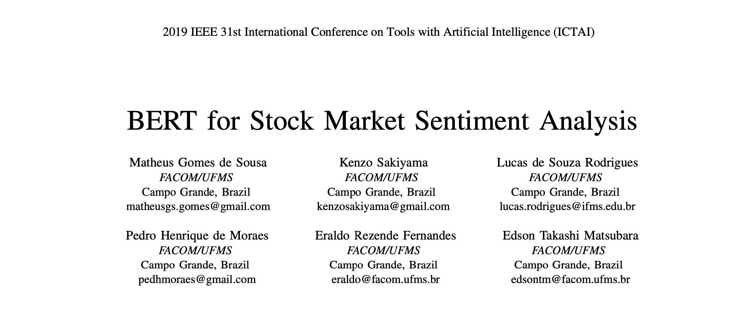
Data

Slide 5
Data
We use news texts and news headlines from this source for the model building. Data were collected from CNBC, Bloomberg, Business Insider, New York Times, Forbes, etc.
Genre: news media
Language: English only
Language Style: both formal and informal language
Size: corpus consists 582 financial news texts and news headlines, all of them are already annotated for sentiment orientation (-1 for negative, 1 for positive). Annotations were performed manually by researchers.
Minor preprocessing of data should be required in the form of tokenization for models like BERT. Data is in json format. Then, we divide the dataset into train, development and test sets to .csv for the model building.
62% of the news in the corpus are negative and and 38% are positive.
Each example includes the headline of the news with a short summary

Slide 6
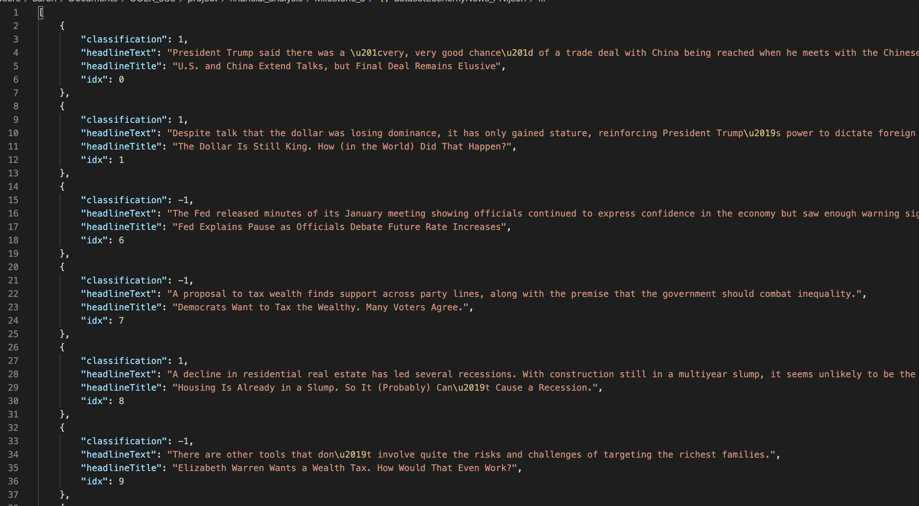

Slide 7
0.79
Model Settings
F1 Score
0.63
Bert + logistic regression
0.81
Bert with both headline and summary of the news
Bert with summary of the news only

Slide 8

Final point
Base on our result, we are able to improve the macro f1 score significantly from our initial model which is from 0.63 to 0.81. In addition, we are able to improve the model from the "BERT for Stock Market Sentiment Analysis" paper because we use BERT-large. Further statistics shows that splitting data is still questionable since it only gives a very small improvement with non splitting data.

Slide 9
Neural Model > Lexicon Based method

Slide 10

Thanks for listening!

